Slide 1
Scrapper Slack
20241105 KimSeongHyun

Slide 2


Slide 3


Slide 4
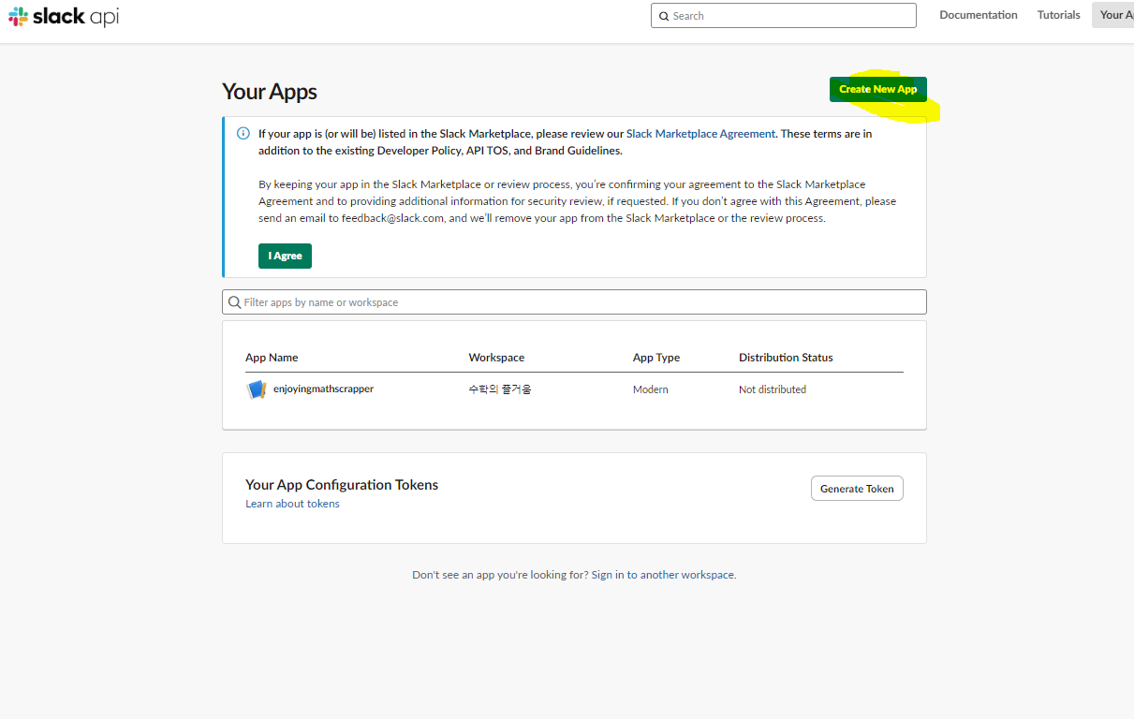

Slide 5
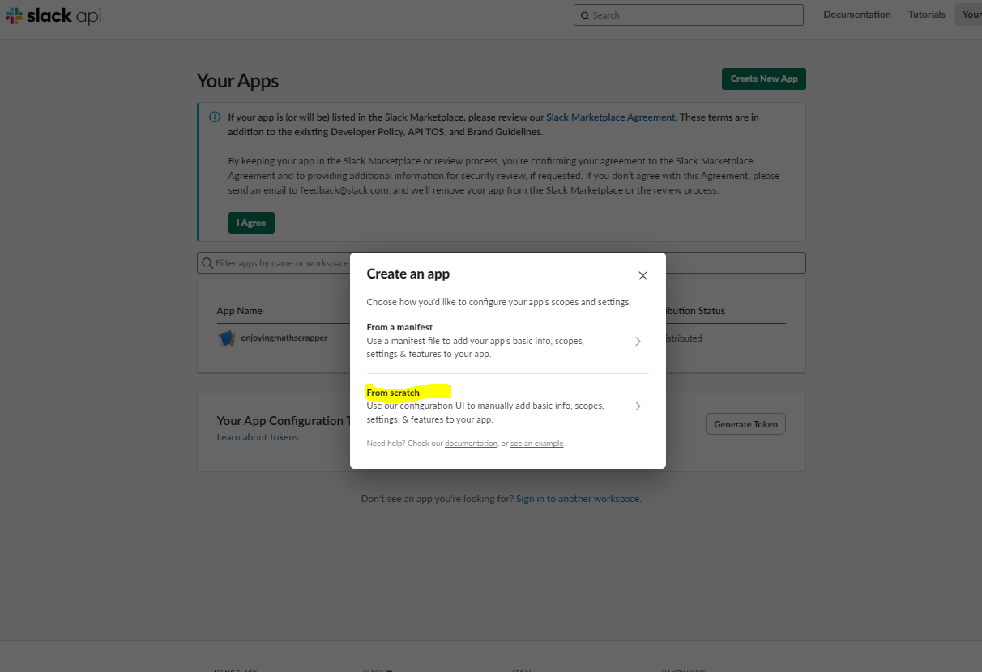

Slide 6
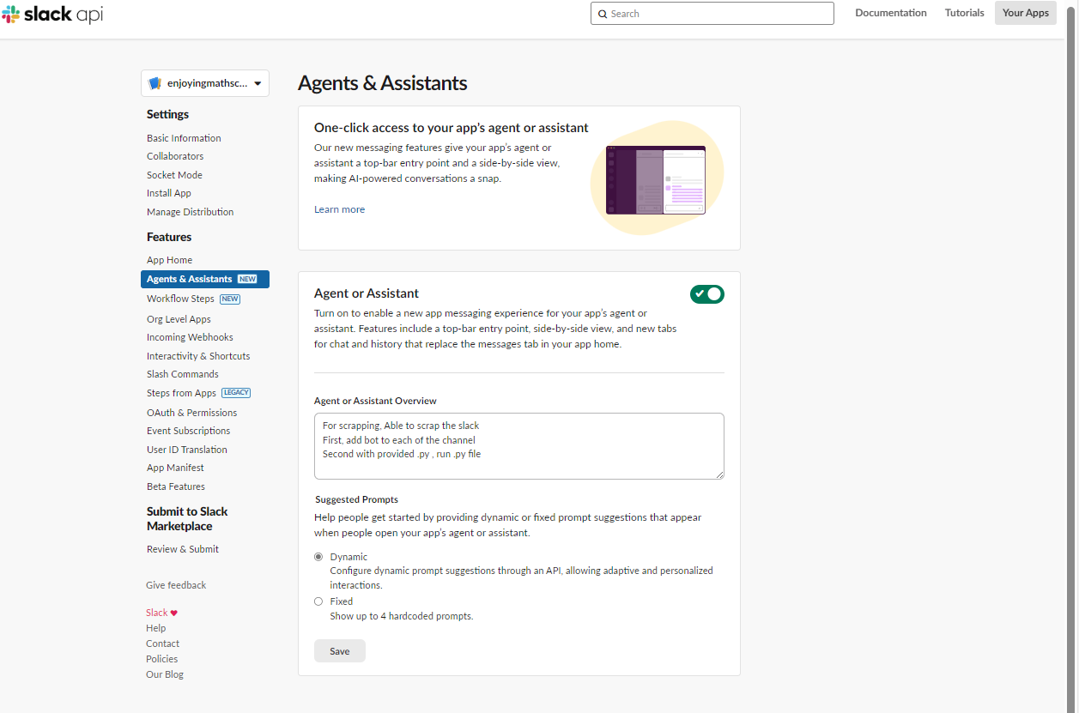

Slide 7
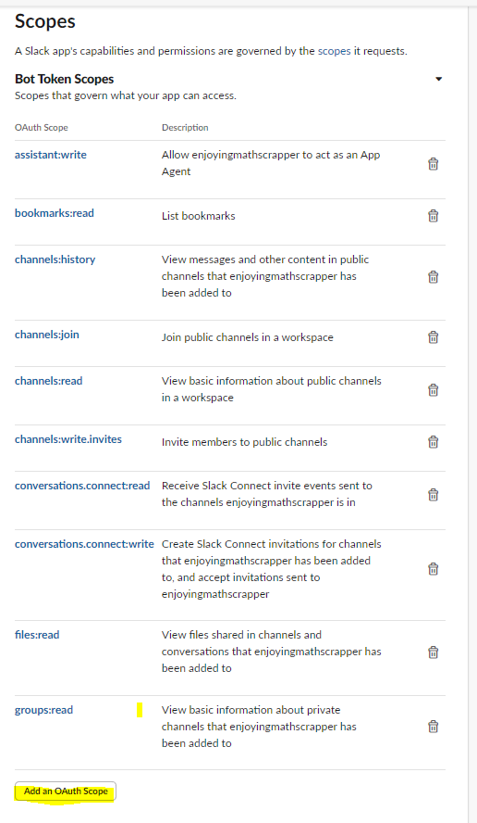

Slide 8
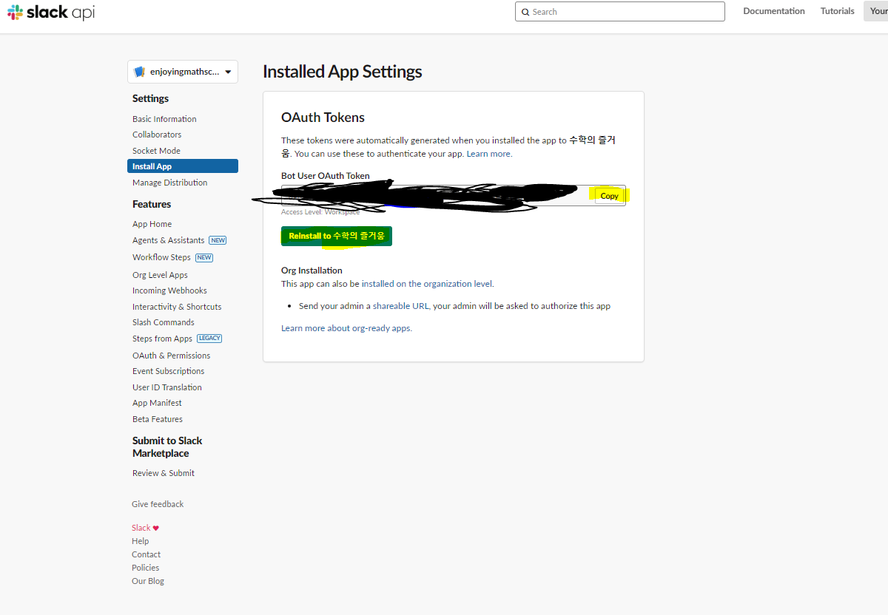

Slide 9
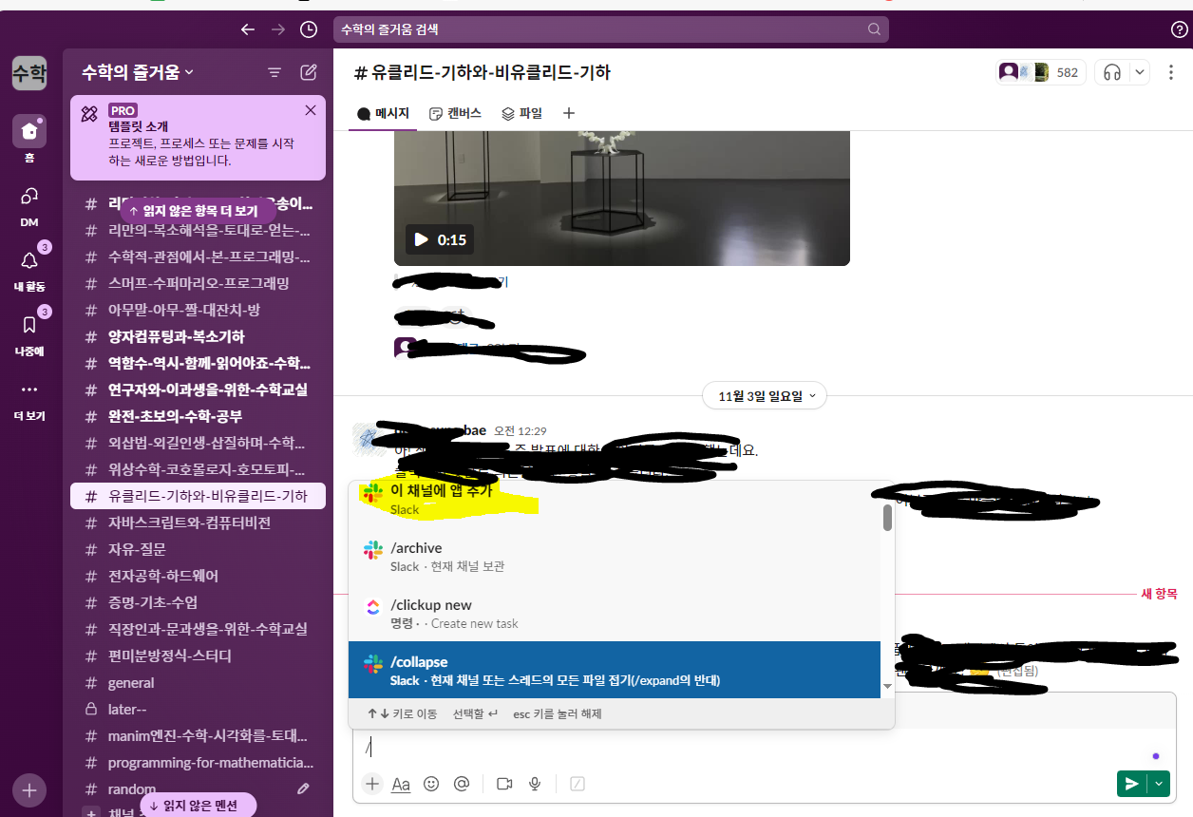

Slide 11
Slack Scrapper
Slack API: Applications | 수학의 즐거움 Slack

